Slide 1
Obesity
Assignment : Obesity-Risk-Scoring-Enhancing-Health-Insurance-Plans
Team of
Anca Kurian, Brian Ngo, Mariam Ibrahim,& Razaul karim

Slide 2
Agenda
Introduction to the Project
Key Research Questions for Machine Learning
Data and Feature Engineering
Model Selection and Evaluation
Ethical Considerations in Machine Learning
Conclusion

Slide 3
Project Introduction
Welcome to the Obesity-Risk-Scoring-Enhancing-Health-Insurance-Plans! Our project focuses on analyzing and predicting
What classifies someone as Obese?
Body Mass Index (BMI) of over 30
What causes Obesity?
Complex, combination of behavior and genetics
What we are looking for?
Understanding and managing obesity risk is important for health insurance companies because it helps reduce healthcare costs, improve customer outcomes, and promote preventive measures. It enables insurers to offer more personalized, effective plans, and aligns with broader public health goals.

Slide 4
Scope of Data and Research
Dataset
This dataset include data for the estimation of obesity levels in individuals from the countries of Mexico, Peru and Colombia, based on their eating habits and physical condition.
Dataset Characteristics :Multivariate
Subject Area :Health and Medicine 1 Associated Tasks :Classification, Regression, Clustering 1 Feature Type :Integer 1 Instances :2111 1 Features : 17

Slide 5
Research Questions
Overview: This project uses machine learning to develop a scoring system for predicting obesity risk, helping health insurance companies optimize their plans.
Goal: To improve the accuracy and personalization of obesity risk predictions, leading to better health outcomes and cost reductions.

Slide 6
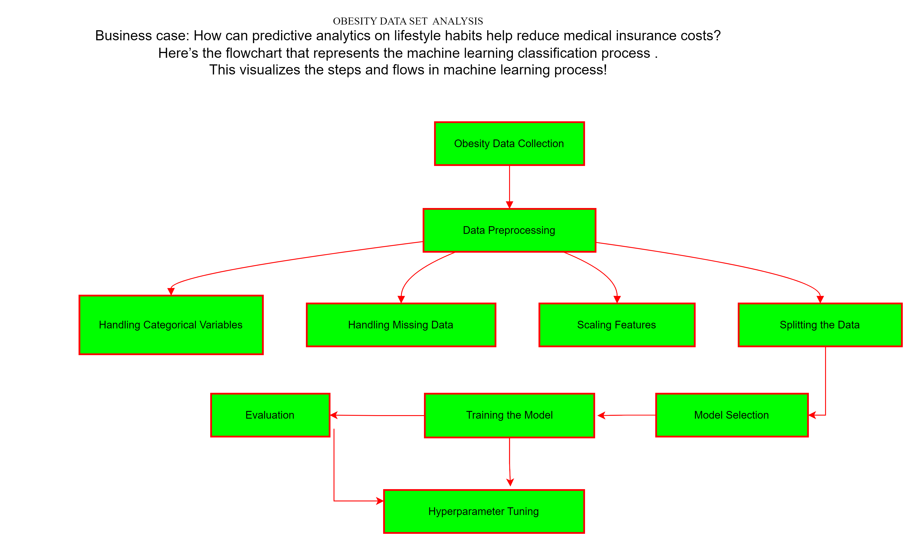
Data Set Analysis

Slide 7
MACHINE LEARNING ALGORITHMS CONSIDERED
By identifying lifestyle risks like smoking or lack of physical activity, insurers can design tailored premiums based on risk levels. Insurance Buyers: Buyers can adopt healthier lifestyle habits to reduce insurance costs by avoiding risk categories such as smoking or high BMI. Technical Solution To address the business case, the following techniques can be applied

Slide 8
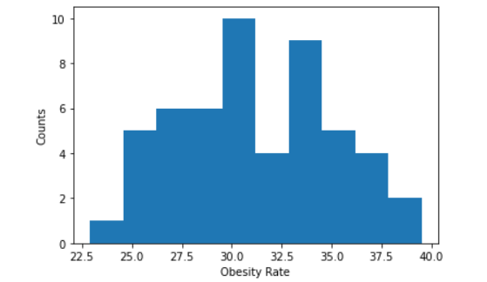
The correlation between both factors is 0.75
Obesity rate by Age, Gender, Ethic and Income
Using Central tendency to describe the dataset
Mean value is 31.28653846153846
Median value is 30.9
Mode is (mode=array([29.5]
Variance 14.662318786982244
Standard deviation 3.8291407374216795 pvalue=0.7813670020801041)
z-scores values are [-0.4665638 1.28317601 ....-0.67548796 0.18632419 2.14498816 -0.5971414 ]

Slide 9
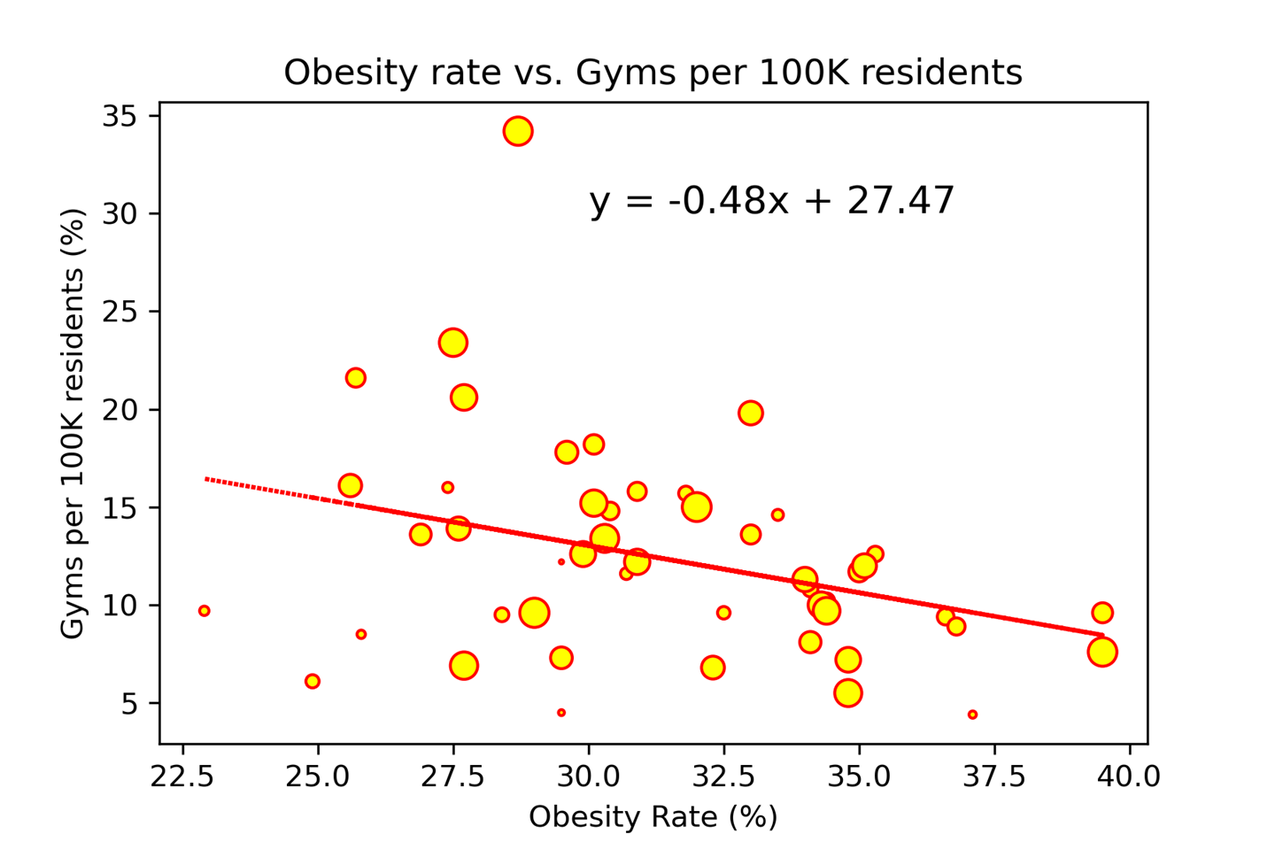
The greater number of gyms in a state, the lower the obesity rate More gyms, more active, hence lower obesity?
Relationship between the Obesity Rate of a state and available Gyms per 100K state residents is a low negative (weak) with the R-value of -0.34.
Despite having more gyms per 100K state residents, it has not much affect on the obesity rates in a state.

Slide 10
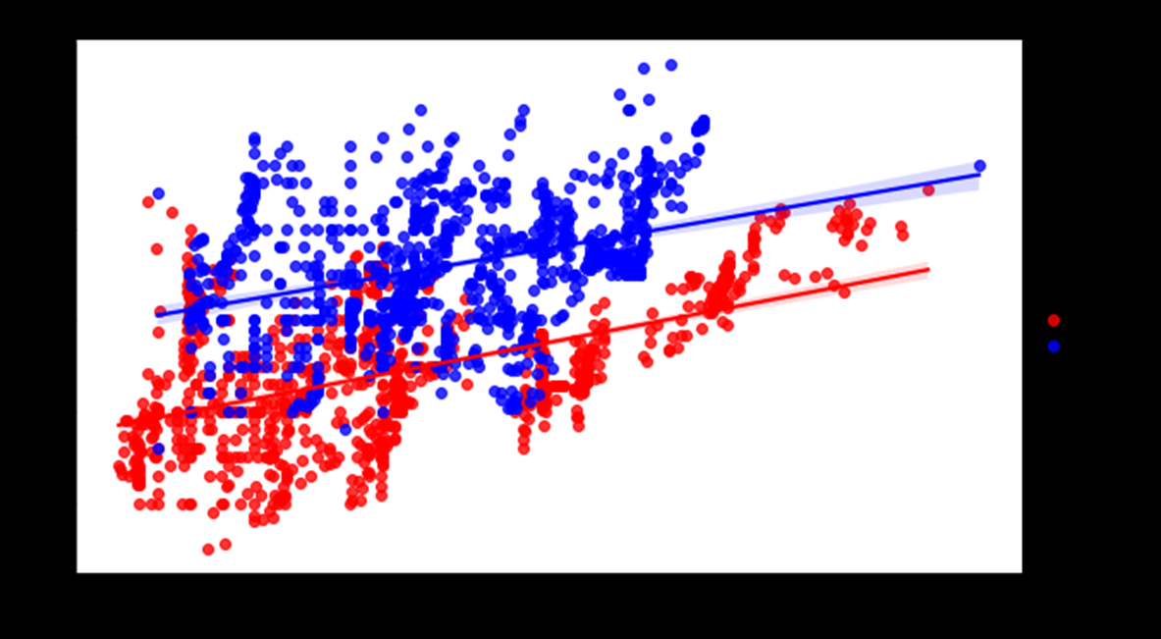
Exploration & Discovery start with exploratory data analysis (EDA)

Slide 11
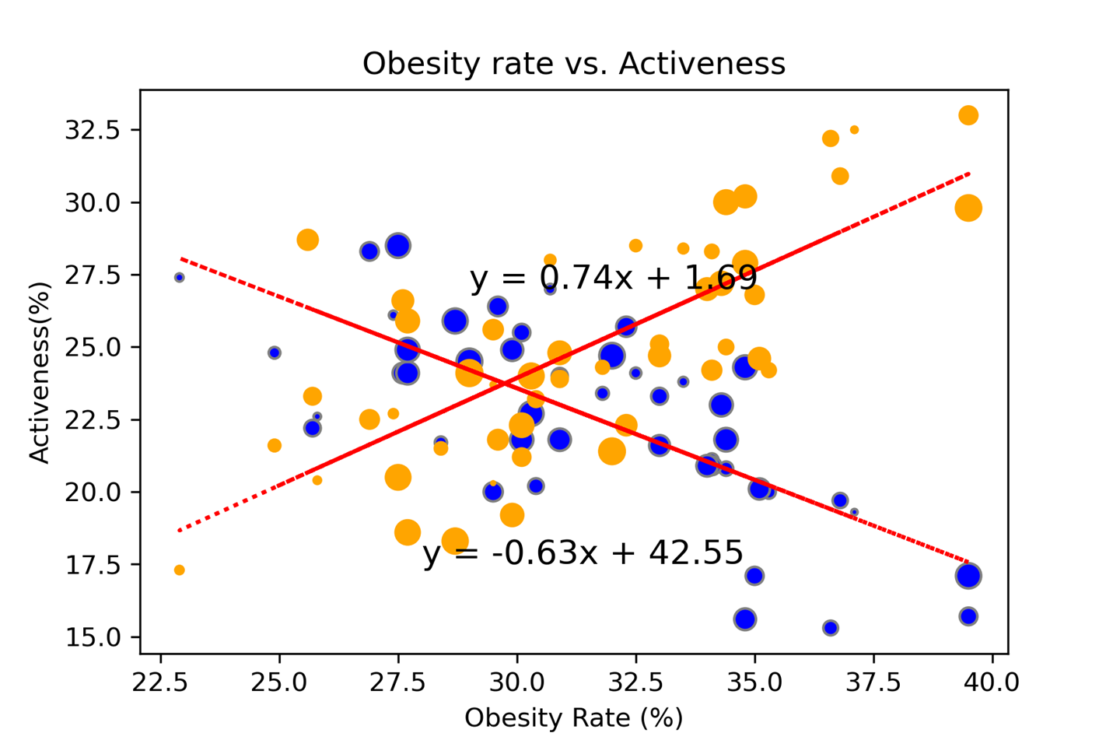
The higher rate of physical activeness, the lower the obesity rate
One of the causes of Obesity defined by the CDC is due to physical inactivity.
Both physical activeness and inactiveness have a strong (but not perfect) relationship between Obesity rate (Both with R value ±0.73)

Slide 12
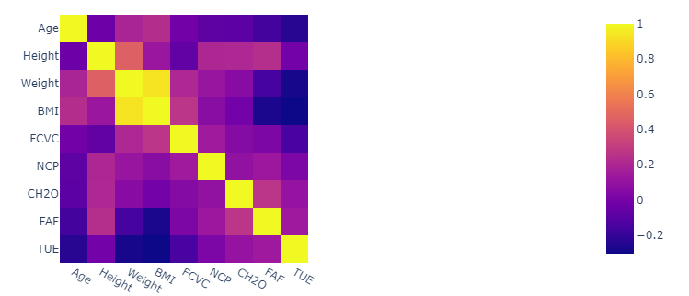
Correlation Analysis: Examine correlations between lifestyle habits (like smoking, alcohol consumption, exercise) and obesity. Visualization: Use scatter plots, histograms, and heatmaps to see the distribution of obesity across gender, age, and lifestyle choices. 3. Business Case The analysis will provide insights for:
FINDING THE CORRELATION BETWEEN THE VARIABLES IN THE DATASET

Slide 13
Distribution of numeric variables
This is usually helpful to quickly grasp the overall shape and spread of the data. This would help identify whether the data is symmetric, skewed to the left or right, or multimodal.
Outliers, which are data points significantly different from other observations, can often be visually identified on histograms as isolated bars at the tails of the distribution.
Observing the distribution of data can also be useful to you can infer the mean, median, mode, and the variability of the data and access ata quality issues such as missing values, unusual distributions, or data entry errors.

Slide 14
MACHINE LEARNING ALGORITHMS CONSIDERED
KNN Classification Goal: Predict obesity class or risk levels based on features like age, BMI, and lifestyle habits. Application: Classify whether an individual is at high or low risk of obesity-related conditions, which can directly impact their insurance premiums. b. Regression Models Goal: Predict BMI or medical costs based on factors such as age, weight, and exercise frequency. Application: Use linear regression or other models to understand how different habits influence BMI and, indirectly, healthcare costs. Clustering

Slide 15
The greater number of gyms in a state, the lower the obesity rate More gyms, more active, hence lower obesity?
Cross-Validation : The provided code uses stratified k-fold cross-validation (`StratifiedKFold`) to split the data into training and validation sets for each fold. This is a technique used to ensure that each fold has a similar distribution of target classes, which can be crucial for imbalanced datasets
Evaluation Metrics: The code calculates and prints a classification report for each fold, which includes metrics such as precision, recall, and F1-score for each class. Additionally, it computes the ROC AUC score for each fold.
Feature Engineering: The code explicitly defines the feature columns (`feature_col_tree`) and the target column (`target`) before training the decision tree classifier. This allows for more flexibility in selecting features and handling the target variable

Slide 16
Obesity rate by Age, Gender, Ethic and Income
Decision Tree Parameters: The provided code initializes the decision tree classifier with a specific criterion (`criterion="entropy"`), which indicates the information gain criterion for splitting nodes in the decision tree. This criterion is different from the default criterion used in the previous example.
ROC AUC Scores: The code computes the ROC AUC score for each fold and stores it in the list `acc_Dtree`. This allows for evaluating the model's performance across different folds using a single metric.
Overall, the provided code includes additional steps such as cross-validation, evaluation with multiple metrics, and explicit feature/target definition.

Slide 17
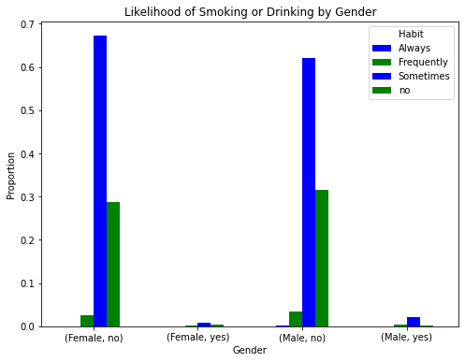
Regression plot Drove Alone
Goal: Group individuals into clusters based on similar lifestyle patterns (e.g., smokers vs. non-smokers, active vs. sedentary).
Application: This segmentation can allow insurers to identify low- and high-risk groups for customized policy offerings.

Slide 18
CONCLUSION
By identifying lifestyle risks like smoking or lack of physical activity, insurers can design tailored premiums based on risk levels. Insurance Buyers: Buyers can adopt healthier lifestyle habits to reduce insurance costs by avoiding risk categories such as smoking or high BMI. 4. Technical Solution To address the business case, the following techniques can be applied

Slide 19
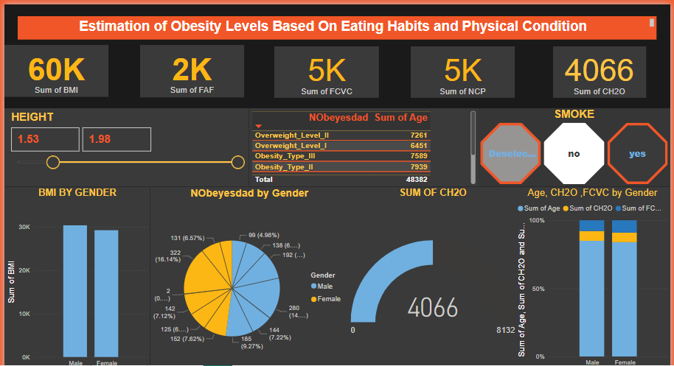

Slide 20
Reference
Git Hub : https://github.com/MRKGITCODE/Obesity-Risk-Scoring-Enhancing-Health-Insurance-Plans
DataSource : https://archive.ics.uci.edu/dataset/544/estimation+of+obesity+levels+based+on+eating+habits+and+physical+condition
DashBoard Power Bi : C:\Users\ibast\Downloads\Obesity.pbix

Slide 21

THANK YOU Questions?

